Slide 1
Aws devops
ow

Slide 2
intro
1. Overview of AWS DevOps and Azure DevOps
2. Code Build
3. Code Commit
4. Code Deploy
5. Code Pipeline
6. Overview of Cloud Formation

Slide 3
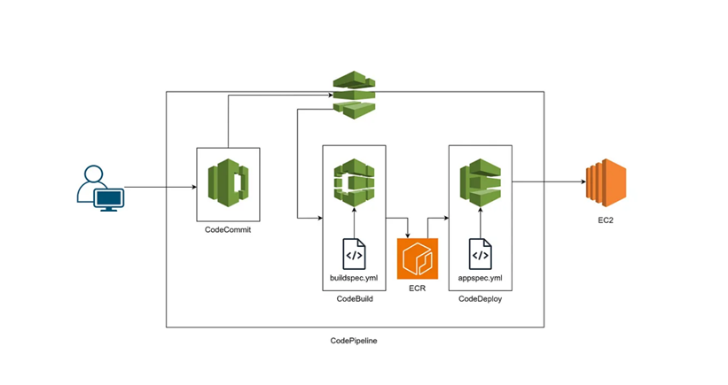
..

Slide 4
Version control
Version control is a system that record changes to a files or set of files over the time that you can recall specific version
It allows you to revert selected files back to a previous state , revert the entire project to a previous state
When you code in a team, we need to place version control in place to revert back the code changes

Slide 5
What is git
Git is a version control system that you can download onto your computer
Git allow developer to collaborate with other developers on a coding project or work on your own project.
Git software has to install on your system
Check git –version
Git is available for windows, linux and MAC

Slide 6
Aws code commit
AWS CodeCommit is a fully-managed source control service that hosts secure Git-based repositories
AWS CodeCommit is a version control service hosted by Amazon Web Services that you can use to privately store and manage assets (such as documents, source code, and binary files) in the cloud
Full managed service provide full administrative task. It’s eliminating any kind of hardware and software managed.

Slide 7
..
CodeCommit provides a console for the easy creation of repositories and the listing of existing repositories.
In a few simple steps, users can find information about a repository and clone it to their computer, creating a local repo where they can make changes and then push them to the CodeCommit repository.
Users can work from the command line on their local machines or use a GUI-based editor.

Slide 8
Lab
After careful consideration, we have made the decision to close new customer access to AWS CodeCommit, effective July 25, 2024. AWS CodeCommit existing customers can continue to use the service as normal. AWS continues to invest in security, availability, and performance improvements for AWS CodeCommit, but we do not plan to introduce new features.
https://aws.amazon.com/blogs/devops/how-to-migrate-your-aws-codecommit-repository-to-another-git-provider/

Slide 9
github
GitHub is a product that allows you to host your Git projects on a remote server somewhere (or in other words, in the cloud).
It's important to remember that GitHub is not Git. GitHub is just a hosting service. There are other companies who offer hosting services that do the same thing as GitHub, such as Bitbucket and GitLab.

Slide 10
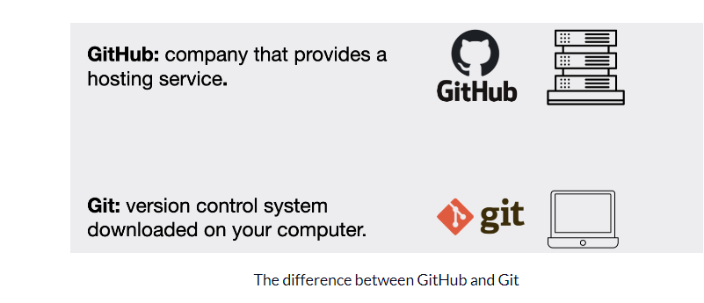
..

Slide 11
..
Git is a distributed version control system that allows multiple developers to work on the same project simultaneously.
It keeps track of all changes made to a file or a set of files, allowing you to easily roll back to a previous version if needed. Here are some basic terms of Gits
Repository
Commit
Push
Pull
Branch
Merge

Slide 12
Getting a Git repository using git init
You typically obtain a Git repository in one of two ways:
You can take a local directory that is currently not under version control, and turn it into a Git repository, or
If you have a project directory that is currently not under version control and you want to start controlling it with Git, you first need to go to that project’s directory.
for Linux:
$ cd /home/user/my_project
And type
git init
This creates a new subdirectory named .git that contains all of your necessary repository files — a Git repository skeleton. At this point nothing in project will be tracked

Slide 13
Set global parameters for user in dev machine
git config --global user.name "<your-firstname> <your-lastname>"
git config --global user.email "<your-email@address>"
EXAMPLES:
git config --global user.name "amit"
git config --global user.email "amit@ow.com"
git config --global --list

Slide 14
lab

Slide 15
Git add
If you want to start version-controlling for existing files , should begin tracking those files and do a initial commit.
“git add” commands that specify files you want to track,.
touch License
git add License

Slide 16
Git commit
In this case, let’s say that the last time you ran git status, you saw that everything was staged, so you’re ready to commit your changes. The simplest way to commit is to type git commit
git commit will add all the files in the latest snapshot.
All changes will go by default in the main branch
git commit –m “first commit”

Slide 17
lab
Try ADD and Commit
Create an account on Githubw

Slide 18
What is SSH Authentication?
SSH (Secure Shell) authentication is a way to securely log into a remote computer or server without using passwords. Instead, it uses SSH key pairs for authentication.
We will use ssh-keygen command to generate
This creates two files:Private Key (id_rsa) → Stays safe on your computer.
Public Key (id_rsa.pub) → Gets copied to the remote server.

Slide 19
Why ssh keys
Why Use SSH Keys Instead of Passwords?
More Secure – Harder to hack than passwords Convenient – No need to type passwords every time Automatable – Useful for scripts and deployments

Slide 20
Git push
git push is a Git command used to upload your local repository changes to a remote repository. When you push changes to a remote repository, Git transfers all your commits to the remote repository, making your local changes available to other contributors.
The basic syntax for the git push command is as follows:

Slide 21

..
Here, <remote> refers to the name of the remote repository (such as origin), and <branch> refers to the name of the branch you want to push to (such as main).
For example, if you want to push your changes to the main branch of the origin remote, you would use the following command:
Before you can push changes to a remote repository, you must first commit your changes to your local repository using the git commit command.

Slide 22
lab

